Slide 1
UE18CS390A – Capstone Project Approval
Project Title : Visual Question Answering on Statistical Plots
Project ID : PW22MHR02
Project Guide : Dr.Mamatha H.R
Project Team : Sneha Jayaraman PES1201802825
Sooryanath I T PES1201802827
Himanshu Jain PES1201802828

Slide 2
Outline
Motivation
Problem Statement
Background Study
Scope and Feasibility study
Applications/Use cases
Expected Deliverables
Capstone (Phase-I & Phase-II) Project Timeline

Slide 3
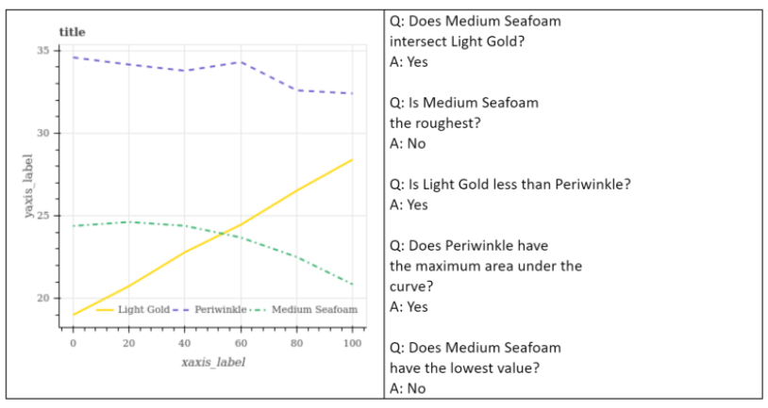
MOTIVATION

Slide 4
PROBLEM STATEMENT
To build a Visual Question Answering system which accepts statistical plots along with user-specific questions with respect to the elements of the underlying plot, such as intersection of the plots, area under the curve and few other varieties of such relational queries, to provide results.
In short, the aim is to build a system that can discover relationships between elements of a plot and provide relational reasoning to answer questions on the plot.

Slide 5
BACKGROUND STUDY
SL NO | Paper Title | Abstract
1 | Answering Questions about Charts and Generating Visual Explanations (Link : https://dhkim16.github.io/vis-qa/pdf/paper.pdf) | The paper provides automatic chart question answering pipeline that generates visual explanations describing how the answers are obtained.
2 | FigureQA: An Annotated Figure Dataset For Visual Reasoning (Link : https://arxiv.org/pdf/1710.07300.pdf) | The paper describes the dataset which consists of yes/no question and contains a huge variety of graphs

Slide 6
SCOPE
Visual Question Answering involves Computer Vision, Natural Language Processing and Deep Learning.
The chosen problem statement is based on Visual QA specific to statistical plots , which has less prevalent work done but has opened the door towards visual reasoning with respect to patterns in statistical plots.
Given an visual image of a statistical plot and a corresponding question, the model must be able to generate a representation of the image, parse and understand the query, and generate a suitable reply. Therefore, it involves an understanding of image and the query language to be able to provide for visual reasoning.

Slide 7
FEASIBILITY
The task of creating a visual question answering system involves 4 steps:
Processing an image to create a representation of the image and identifying the components of it. The image in this context is that of a plot.
Processing the input relational question as a sequence of words in a pipeline.
Mapping the question to the appropriate components of the image.
Providing a suitable answer with acceptable confidence.
The plots we intend to explore on are - Vertical and Horizontal Bar Graphs, Pie Charts, and Line Plots.

Slide 8
CHALLENGES
Construction of an efficient Image channel and Question channel by retaining the roots from the baseline model.
Questions on smoothness and roughness of curves/plots .
Attempting to inculcate open ended queries and responses with respect to the input plot image.
Might require text recognition modules(OCR) for graph annotations.

Slide 9
APPLICATIONS/USE CASES
Statistical charts are an intuitive and simple way to represent data. Deep Learning focuses on emulating human intelligence to develop new models that can reason figures and understand relationships that are intuitive to humans. Therefore, it is useful to build a model that can reason visual data in statistical plots.
It becomes important to analyse digital images through the content of the image rather than the tags or metadata associated with it, to better describe the image, more so in the case of data visualisation charts.

Slide 10
APPLICATIONS/USE CASES
Visual plots are commonly found in research papers, scientific journals, business records e.t.c. Therefore, automation of plot analysis through the means of question-answering aids an individual to draw statistical inferences quickly from them.
Visual question answering models on charts, help data analysts question and reason plots on a large scale, and automate the decision-making capabilities in several sectors.
Eg : Finance sector.
Improvement in machine reasoning capabilities.

Slide 11
EXPECTED DELIVERABLES
Capstone-I deliverables
Having thorough knowledge of the problem statement.
Research on existing standard models; their performance on the dataset and their setbacks.
Exploring the baseline models.
Developing the model architecture to build the solution.
Capstone-II deliverables
Building the software solution to the problem
Analyzing the results and comparing with state-of-art papers
Preparing a GUI for the application

Slide 12

Capstone (Phase-I & Phase-II) Project Timeline
Project Phases:
Research :
Existing work done in the domain.
Determine the areas of improvement from prevailing works.
Literature Review.
Model Formulation :
Design the architecture to implement the problem.
Ensure the novelty of the idea.
Implementation :
Design the workflow of the implementation.
Code the implementation.
Review and Results :
Test the solution and improve the performance and comparisons of results.
Design custom test cases if required
Final Report :
Demo the final work
Write the paper for publication
Individual Tasks:
The plan is to equally divide the work among the three members and conduct a smooth flow of the research.

Slide 13
Thank You

